Slide 1
Product Information and Partnership Proposal
Positioning, specifications and implementation of four fictional medical products
Presented by
Prepared for
Happy Group
Chenggong Medical Institution
Product information | Fictional case study

Slide 2
Product Portfolio Overview
Four products for different care settings. All names, specifications and prices are fictional teaching data.
Product code | Product name | Category | Dosage form | Standard unit price | Shelf life | Core positioning
P1001 | Yaoheng Injection | Neurology | Injection | NT$240,000 / box | 2 years | Cold-chain tracing and clinical handover
P2001 | Anbo Lyophilized Injection | Oncology | Lyophilized injection | NT$700 / vial | 3 years | Strength selection and batch control
P3001 | Tonghu Oral Solution | Pediatrics | Oral solution | NT$180 / bottle | 2 years | Dose understanding and home use
P4001 | Wenmian Tablets | Immunology | Tablets | NT$1,300 / box | 2 years | Regular dosing and medication tracking
Proposal Focus
Happy Group presents product information, storage conditions and implementation steps in a consistent format so Chenggong Medical Institution can assess care settings and management needs.
Happy Group × Chenggong Medical Institution | Product Proposal 02
Fictional case study | Aiworks classroom practice

Slide 3
Product Positioning and Institutional Needs
Link product features to institutional workflows for a clear, actionable implementation assessment.
Partnership Perspective
Product | Primary setting | Institutional priorities
Yaoheng Injection | In-hospital injection and cold-chain handover | Temperature logs, batch tracing and backup stock
Anbo Lyophilized Injection | Oncology preparation and inventory | Strength selection, batch control and reorder points
Tonghu Oral Solution | Pediatric outpatient and home use | Dose understanding, opening dates and caregiver use
Wenmian Tablets | Chronic immunology follow-up | Dosing logs, visit reminders and budget planning
From Product Specifications to Care Workflows
Alongside dosage form and price, Chenggong Medical Institution needs to understand storage, staff training, record ownership and patient communication. Happy Group recommends reviewing implementation requirements across care settings, workflows and documents.
Shared goal: close information gaps and make product management and instructions more consistent.
Happy Group × Chenggong Medical Institution | Product Proposal 03
Fictional case study | Aiworks classroom practice

Slide 4
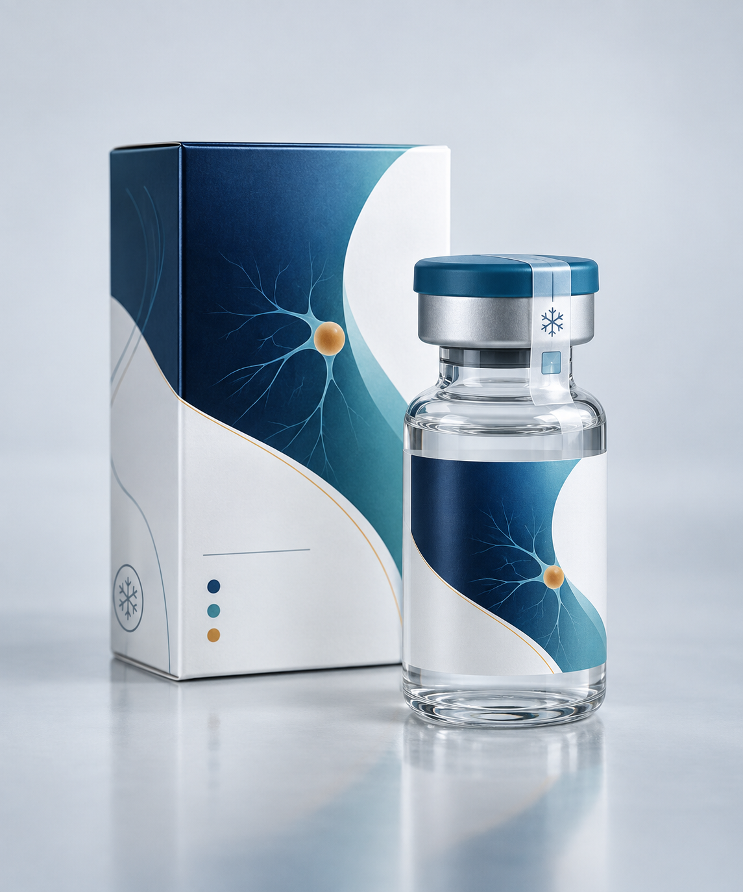
Yaoheng Injection P1001
Neurology | Injection | Fictional product
Functional Positioning
Injection for Acute Neurological Support in Hospital
Yaoheng Injection is a fictional neurology support product for short-term hospital use. Its imagined mechanism regulates overactive nerve signals, giving clinical teams an option after assessing acute symptoms. Single-use packaging helps nurses check batch numbers and use status.
Uses and Care Settings
Use setting: hospital care with physician assessment, vital-sign monitoring and injection support. The product may be placed in neurology wards, emergency observation areas or day-treatment units. Eligibility and timing follow the fictional institutional protocol.
Basic information | Product details
Pack / storage | 2 mL / vial, 10 vials / box; refrigerate at 2-8°C
Shelf life / price | 2 years; NT$240,000 / box
Use and Management Precautions
Precautions: check identity, package integrity and cold-chain records before use. Quarantine damaged packaging, abnormal-looking solution or products exposed to temperatures outside the specified range for pharmacy review. Record the batch, time and observations after use.
Fictional teaching description. Not for diagnosis, prescribing or actual medication use.
Happy Group × Chenggong Medical Institution | Product Proposal 04
Fictional case study | Aiworks classroom practice

Slide 5
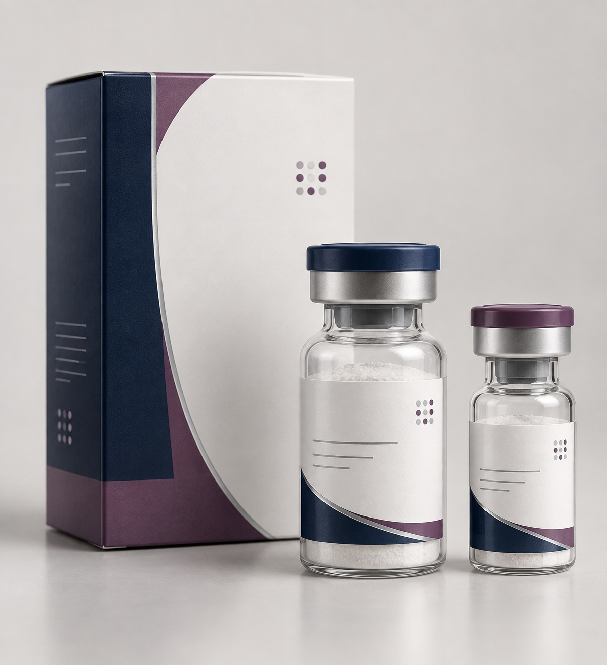
Anbo Lyophilized Injection P2001
Oncology | Lyophilized injection | Fictional product
Functional Positioning
Lyophilized Support Product During Oncology Treatment
Anbo Lyophilized Injection is a fictional supportive product for oncology treatment. Its imagined mechanism helps clinical teams manage specific physiological burdens during therapy. The lyophilized form supports long-term storage, with two strengths for institutional stock planning.
Uses and Care Settings
Use setting: after an oncologist's assessment, pharmacy staff prepare the product under institutional procedures. The smaller strength suits low-volume use; the larger strength supports centralized preparation. Set safety stock and reorder points using average consumption.
Basic information | Product details
Pack / storage | 50 or 100 mg / vial, 5 vials / box; room temperature, protect from light
Shelf life / price | 3 years; NT$700 / vial
Use and Management Precautions
Precautions: check the vial, expiry and batch before preparation. Reconstitute and inspect appearance under the fictional procedure. Store strengths separately to avoid selection errors. Do not independently retain unused contents or mix them with other batches.
Fictional teaching description. Not for diagnosis, prescribing or actual medication use.
Happy Group × Chenggong Medical Institution | Product Proposal 05
Fictional case study | Aiworks classroom practice

Slide 6
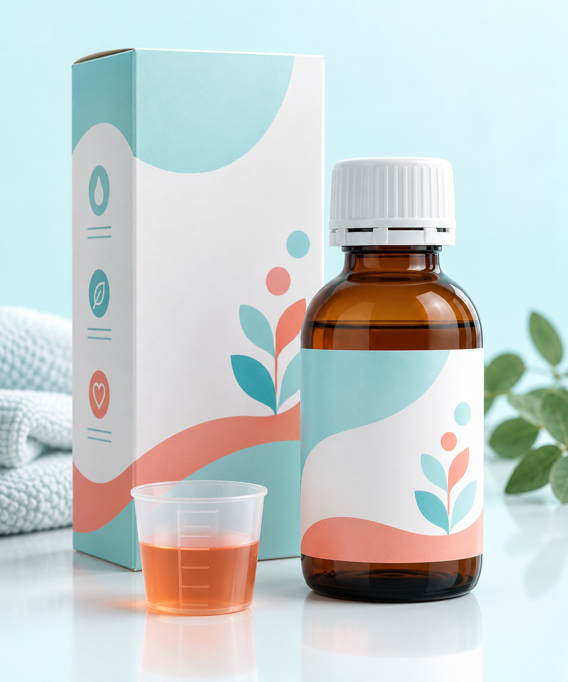
Tonghu Oral Solution P3001
Pediatrics | Oral solution | Fictional product
Functional Positioning
Oral Liquid for Short-Term Pediatric Discomfort
Tonghu Oral Solution is a fictional product for short-term pediatric symptom care. Its imagined action eases common mild discomfort, offering an easier-to-swallow form after clinical assessment. The liquid allows individual measurement, with a dedicated cup to reduce estimation differences.
Uses and Care Settings
Use setting: children who have difficulty swallowing tablets and need caregiver support. At dispensing, explain cup markings, daily records and the opening date. Ask caregivers to describe the steps in their own words to confirm understanding.
Basic information | Product details
Pack / storage | 120 mL / bottle, with cup; room temperature, protect from light
Shelf life / price | 2 years unopened; NT$180 / bottle
Use and Management Precautions
Precautions: do not substitute a household spoon for the cup or increase frequency independently. If discomfort persists, eating becomes difficult, or skin reactions or other abnormalities occur, caregivers should stop self-management and contact a clinician. Observe the labeled period after opening.
Fictional teaching description. Not for diagnosis, prescribing or actual medication use.
Happy Group × Chenggong Medical Institution | Product Proposal 06
Fictional case study | Aiworks classroom practice

Slide 7

Wenmian Tablets P4001
Immunology | Tablets | Fictional product
Functional Positioning
Regular Oral Therapy for Chronic Immunology Care
Wenmian Tablets are a fictional product for chronic immunology care. Their imagined action moderates excessive immune responses to support long-term care plans. Fixed doses and monthly packs support regular dosing records and help institutions arrange follow-up and refill reminders.
Uses and Care Settings
Use setting: adults requiring ongoing follow-up after a full immunology assessment. Use paper logs or the institution's reminder system. At each visit, review dosing, lifestyle changes and unresolved questions.
Basic information | Product details
Pack / storage | Fixed-dose tablets, 30 / box; room temperature, keep dry
Shelf life / price | 2 years; NT$1,300 / box
Use and Management Precautions
Precautions: review medical history, other medicines and recent health before use. Contact a clinician promptly if clear signs of infection, persistent fever or unusual reactions occur. Do not stop, increase the dose or share the product independently.
Fictional teaching description. Not for diagnosis, prescribing or actual medication use.
Happy Group × Chenggong Medical Institution | Product Proposal 07
Fictional case study | Aiworks classroom practice

Slide 8
Product Comparison and Key Messages
Consistent comparison fields help Chenggong Medical Institution identify implementation requirements.
Comparison area | Yaoheng Injection | Anbo Lyophilized Injection | Tonghu Oral Solution | Wenmian Tablets
Primary users | Hospital neurology team | Oncology pharmacy team | Pediatric caregivers | Immunology follow-up patients
Management complexity | High: cold-chain handover | Medium: strengths and batches | Medium: opening and dosing | Low to medium: follow-up
Key documents | Temperature and handover logs | Inventory and batch cards | Dosing instruction card | Medication tracking form
Communication focus | Storage and incident handling | Strength selection and restocking | Ease of use for caregivers | Follow-up and refill timing
Comparison Summary
The products differ mainly in their management workflows. Chenggong Medical Institution can set the implementation order based on its equipment, staff and existing documents.
Happy Group × Chenggong Medical Institution | Product Proposal 08
Fictional case study | Aiworks classroom practice

Slide 9
Implementation Recommendations for Chenggong
Happy Group proposes four weeks for workflow review, document preparation and a limited pilot.
Phase | Institution's tasks | Happy Group support | Expected output
Week 1: Review | Confirm settings, storage equipment and owners | Provide a product information checklist and interview questions | Current-state review form
Week 2: Design | Select handover, inventory, patient education or follow-up workflows | Compile relevant sample documents | Draft workflows and responsibilities
Week 3: Pilot | Run simulations in one unit | Help compile issues and revise materials | Pilot records and issue list
Week 4: Confirm | Confirm final versions and training approach | Complete the information pack and briefing | Institutional implementation pack
This teaching schedule may be adjusted to Chenggong Medical Institution's actual workflows.
Happy Group × Chenggong Medical Institution | Product Proposal 09
Fictional case study | Aiworks classroom practice

Slide 10
Partnership Priorities
Product Information for Institutional Workflows
Happy Group will tailor product information and implementation documents to Chenggong Medical Institution's storage conditions, responsibilities and training needs. The next step is to select one product, review the unit's workflow and design a pilot.
Presented by Happy Group
Prepared for Chenggong Medical Institution
All products, specifications, prices and scenarios in this presentation are fictional teaching data.

